Slide 1
EDA ASSIGNMENT

Slide 2
AIM:
The aim is to identify the patterns which can help to understand the clients :-
Who have difficulty paying their instalments should not be given loan as it will cause business loss.
Who can make the payments on time and should be given loan as it will help to get business profit

Slide 3
PROCEDURE :
Import the dictionaries like pandas, NumPy, matplotlib, statistics etc. and read the datasets
Understand the columns in application dataset and the column dictionary will provide the guidance to understand all the parameters also find the key driving factor in the dataset.
Followed by that find the shape , describe and info details to get the overall details of the dataset.
Next is data cleaning , in this we should find the % of null values present in individual column and drop it if its required or impute it.

Slide 4
In the application dataset, we have 122 columns and 307511 row entities.
When I gone through the data , I decided to eliminate column with more than 50% of null values for better analysis. After dropping dataset shape became (307511, 81)
Next step was to identify the continues and categorical variables.
Followed by that , done the imputation for the rest of the null values.
For the continuous variable columns, impute the values with median of the respective columns and for categorical columns , impute with mode value.
Now null values are cleared.
Also checked the data type... No need of any changes

Slide 5
Some of the columns likes 'DAYS_BIRTH’ , 'DAYS_EMPLOYED’ , 'DAYS_REGISTRATION’ , 'DAYS_ID_PUBLISH’ have some issues with their values. Need to change the values to days and took the absolute values.
Eg: inp1.DAYS_BIRTH=abs(inp1.DAYS_BIRTH/365)
Our key driving factor is TARGET, depend on this we decide the defaulters and non defaulters. Ie. TARGET value 1: defaulters and 0: non defaulters.

Slide 6
Correlation Matrix
We can find the correlation matric of continuous variables.
First need to create the matrix using corr() function and then prepare heatmap.
Heat map is mention on the next slide, base on that we can easily find out the top 10 correlated variables.
Top 10 Correlation:
"AMT_CREDIT", "AMT_GOODS_PRICE", "FLOORSMAX_MODE", "YEARS_BEGINEXPLUATATION_MODE", "YEARS_BEGINEXPLUATATION_MEDI", "FLOORSMAX_MEDI","FLOORSMAX_AVG", "YEARS_BEGINEXPLUATATION_AVG", "AMT_ANNUITY","TOTALAREA_MODE"

Slide 7
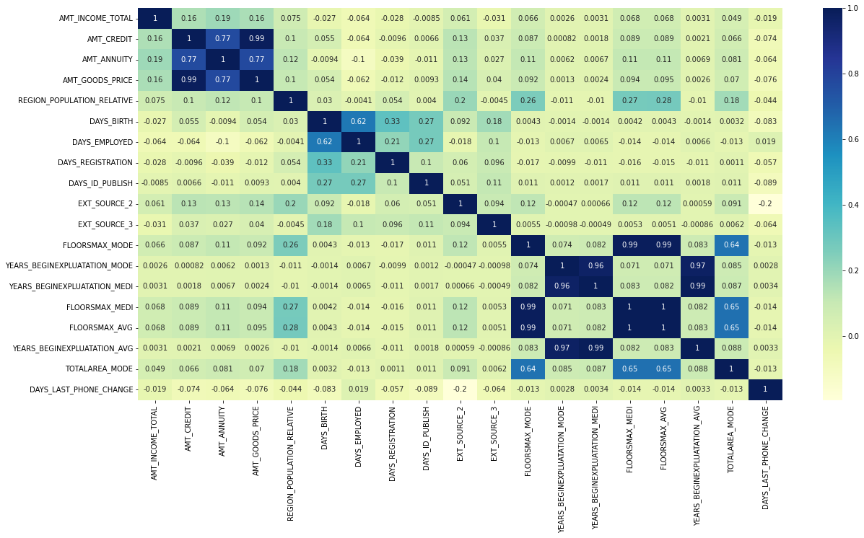
Correlation matrix

Slide 8
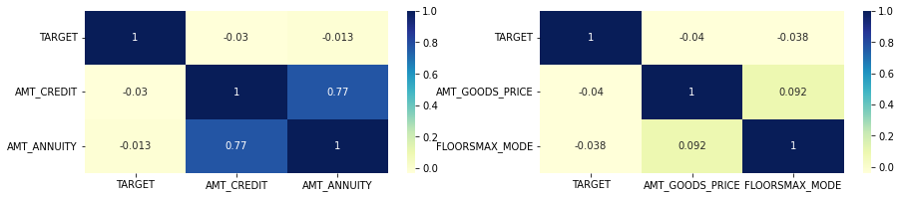
Categorical correlation sample :

Slide 9
Data Imbalance:
From TARGET variable we can find out the data imbalance.
Observations:
More than 90% of payments are defaulters ie. late payment more than X days on at least one of the first Y installments of the loan in our sample.
Huge difference between the defaulters and non defaulters.
Imbalance percentage: (inp1.TARGET==0).sum() / (inp1.TARGET==1).sum()
Imbalance percentage =11%

Slide 10
Outliers:
An outlier is a data point in a data set that is distant from all other observation.
A data point that lies outside the overall distribution of dataset.
Outliers exist due to Variability in the data or an Experimental measurement error.
We can identify the outliers by using:
Box plot
Scatter plot
We can treate the outliers in two ways :
Interquartile Range(IQR) Method
Capping

Slide 11
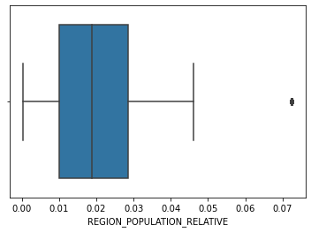
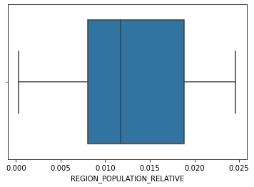
OUTLIER Treatment : By using IQR
REGION_POPULATION_RELATIVE before treatment
REGION_POPULATION_RELATIVE before treatment After Treatment

Slide 12
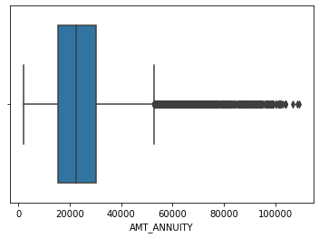
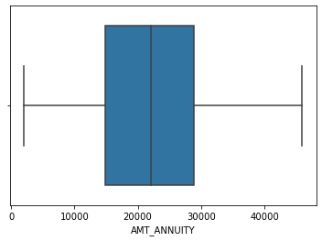
OUTLIER Treatment: By using capping
AMT_ANNUITY before capping treatment
AMT_ANNUITY after capping treatment

Slide 13
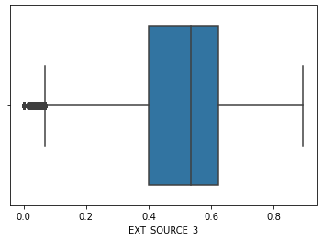
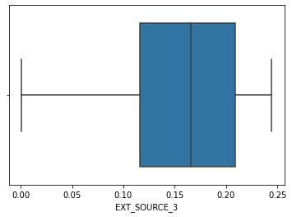
OUTLIER Treatment: By using capping Lower whisk capping
EXT_SOURCE_3 before capping treatment
EXT_SOURCE_3 after capping treatment

Slide 14
Data frame Division
Next step is to divide the data frame in to two according to key driving factor.
ie, inp1_1 is the data frame contains TARGET=1
inp1_0 is the data frame contains TARGET=0
Shape of the two data frames are
inp1_1 : (3210 , 81)
Inp1_0 : (11596,81)

Slide 15
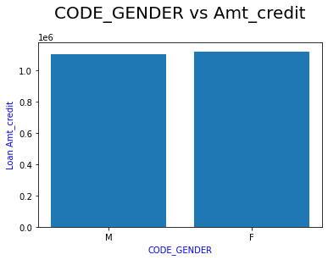
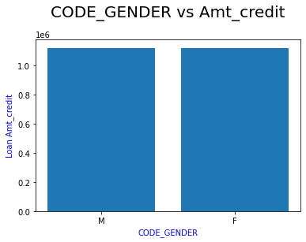
Bivariant Analysis
CODE_GENDER and AMT_CREDIT variables are analysing on both datasets
Categorical and continuous variable analysis.
Both defaulters and non-defaulters have almost same values.
That means there is no gender difference for loan amounts.

Slide 16
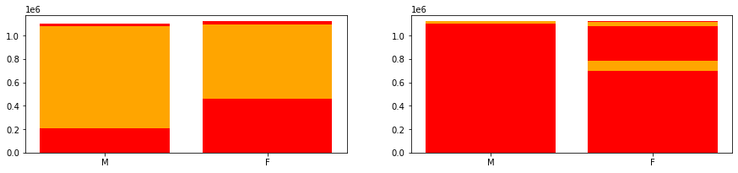
Bivariant Analysis
CODE_GENDER and AMT_CREDIT variables are analysing on both datasets.
Males have more loan granted and they have more difficulties to pay back.
In case of non defaulters also mails are high
Females are also facing issue for loan payment but its less than males.
In case of non defaulters females are high

Slide 17
Analysis of Previous_application data set
Same procedure we have to do for previous application dataset (name as inp0).
Initially find the shape , describe and info details to get the overall details of the dataset.
Next is data cleaning , in this we should find the % of null values present in individual column and drop it if its required or impute it.
Shape: (1670214 , 37)
In previous application data set has only two columns which has >99% missing values so we drop that columns
While analysing the data some columns contains “XNA” and “XAP”, we considered it as null values.
And impute the necessary changes to avoid null values ( ie. For the continuous variable columns, impute the values with median of the respective columns and for categorical columns , impute with mode value.)

Slide 18
Merging Data Frames
Next step is to merge data frames, here I have done an inner joint of inp1_1 and inp0 on SK_ID_CURR and inp1_0 and inp0 on SK_ID_CURR.
Shape of both data frames are:
Inp1_1: (18150 , 114)
Inp1_0: (63145 , 114)

Slide 19
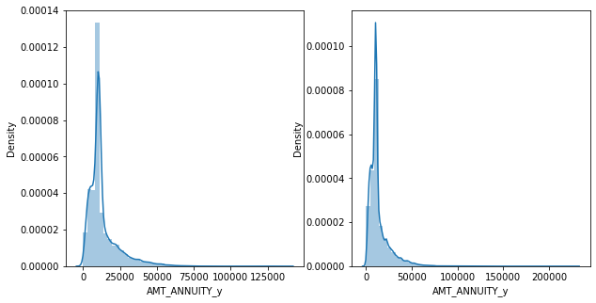
Univariant Analysis: Analysis of AMT_ANNUITY of both defaulters and non defaulters. Here is a Seaborn Distplot for better understanding

Slide 20
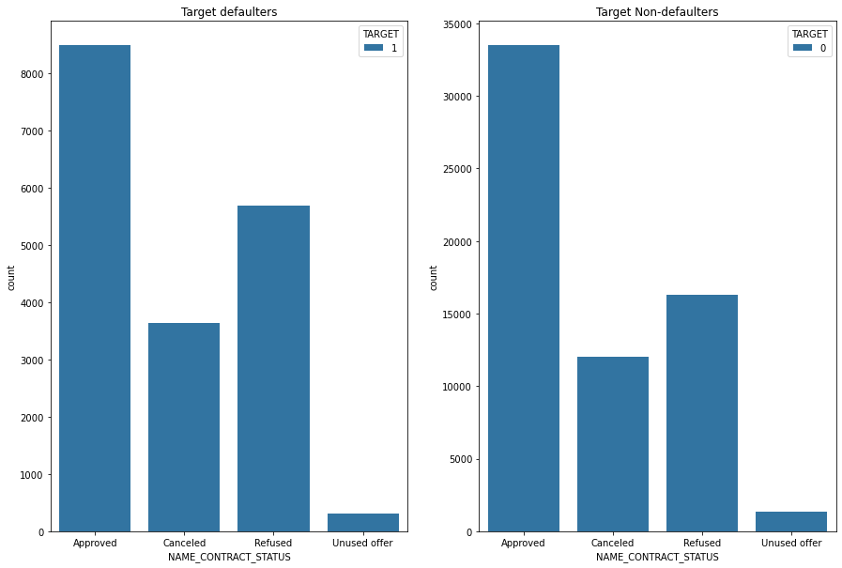
Univariant Analysis:

Slide 21
Observations:
Great deference between the defaulters and non defaulters in there contract status.
But in both cases Approved cases are more than the rest of the status.
Used offers are very less in defaulters.

Slide 22
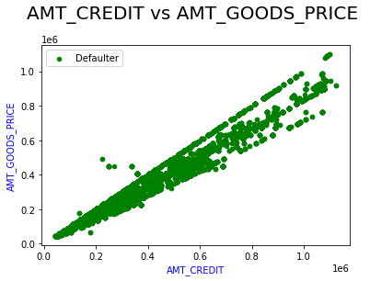
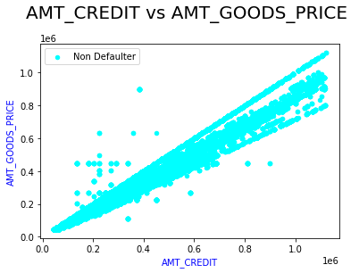
Bivariant Analysis: Amount credited for loan and Price of the good which the loan is given.
Defaulter
Non defaulter

Slide 23
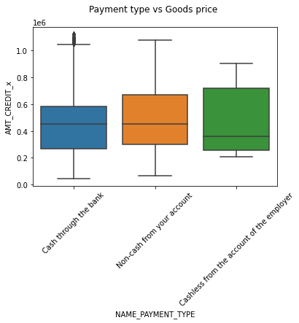
Bivariant Analysis: Payment type vs Goods price

Slide 24
Conclusion
We have done all the necessary changes in the dataset and merge the application dataset and previous application dataset.
Also we done the outlier treatment and necessary visualisations
Finally done the univariant and bivariant analysis of both merged and unique dataset, observation are also mentioned.

